Slide 1
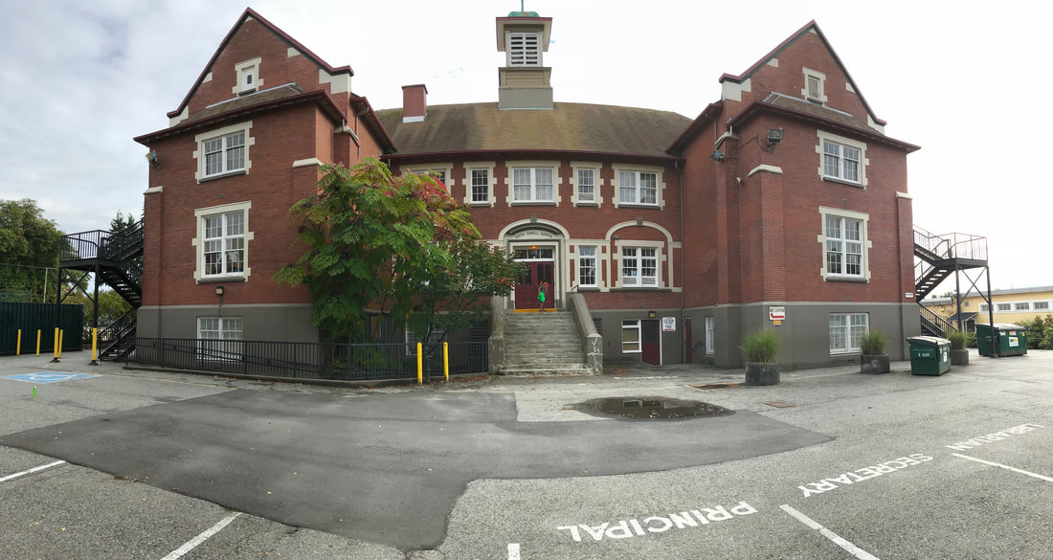
file:///.file/id=6571367.15899009

Slide 2
Cavell Seismic Upgrade
Seismic Committee Presentation | 29 Oct 2018

Slide 3
On 28 Sept, 2018, the Ministry of Education announced that the VSB would receive $15.8M in funding for seismic upgrades at Cavell

Slide 4
Cavell students to be bussed to two different swing schools located near Boundary and East 49th Ave. (MacCorkindale and Champlain Heights)

Slide 5
Construction was announced to be from Spring 2020 to Fall 2021 Later it came to parent attention that an earlier move date of June 2019 is under consideration

Slide 6
VSB applied to the Ministry of Education for $7M in capital funding to expand the school from 280 students to 485 students VSB will not hear back until June 2019 This funding is not guaranteed

Slide 7
Objectives
Summary of parent survey
What we know so far
Consultation and process
Swing sites
Kingsford-Smith
Information available
Timeline
Coriolis report
Long Range Facilities Management Plan
Next steps

Slide 8
Summary of survey
There were 222 responses to the survey out of a school population around 280
91.8% of respondents were not satisfied with the proposed plan
91.8% of respondents were not satisfied with the proposed swing sites
95.9% of respondents supported the Seismic Committee advocating for a better swing site
56.6% of respondents indicated their top priority for a swing site was to be closer to Cavell and a single site
34.2% of respondents indicated their top priority for a swing site was to be closer to Cavell
Notes:
May require more than one slide

Slide 9
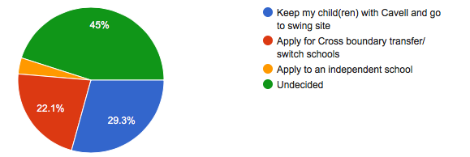
Summary of survey
91% of respondents supported advocating for seismic upgrading and school expansion to occur at the same time
If the seismic upgrade were to occur as announced by the VSB , only 29.3% of respondents would stay at Cavell and commute to the proposed swing sites
Notes:
May require more than one slide

Slide 10
What we know so far – consultation and process
The community does not want the seismic project to be delayed
Parents have been engaged/consulted by VSB staff on other seismic projects much earlier in the timeline
We were not engaged until the information meeting on 16 October 2018
Historically, seismic projects appear to have been modified after parent/community consultation
Parent advocacy has been effective at stopping school closures and delaying the proposed school boundary changes

Slide 11
What we know so far – swing sites
VSB currently has three swing sites:
South Hill (Fraser @ East 45th Ave.)
Queen Elizabeth Elementary (Camosun @ West 16th Ave.)
MacCorkindale Elementary and Champlain Heights Elementary (Boundary @ East 49th Ave.)
VSB staff indicated there are no other possible swing sites

Slide 12
What we know so far – Kingsford-Smith
Kingsford-Smith Elementary has been the only user of the MacCorkindale/Champlain Heights swing sites
Parents, teachers, and the PAC have expressed serious concerns about the swing site, despite their close proximity
Loss of students, loss of teachers, negative impact on PAC fundraising, loss of extracurricular activities, students have been split from siblings and close friends, unsupervised bus trips, different rules for students from Kingsford-Smith vs existing students
Kingsford-Smith has attempted to provide feedback to VSB unsuccessfully

Slide 13
What we know so far – information available
Every school in Vancouver to be seismically upgraded/replaced by 2030
25 have been completed
5 are under construction
7 are proceeding to construction (including Cavell)
8 are in business case development
65 out of 110 VSB schools remain
Ministry of Education has established that the lowest cost option must be chosen for proceeding (replacement vs upgrading)

Slide 14
What we know so far – timeline
2020 deadline announced for BC seismic upgrading
Office of the Comptroller General Report
PWC Report
Deloitte Report
MOU signed to create Project Office
Deloitte Report
2011
2013
2010
2012
2014
Coriolis Report released
Deloitte Report
Notes:
2010: Deadline of 2020 announced for all of BC’s high-risk schools to be seismically upgraded
2010: Office of the Comptroller General Report released highlighting the need for long-range planning
2012: VSB engaged PwC to conduct a resource allocation review identifying opportunities for increased cost effectiveness and revenue opportunities
2012, 2013, 2014: Deloitte engaged to create reports focusing on cost savings and shared cost service opportunities to save administrative costs and improve service delivery
2014: Memorandum of Understanding signed between Ministry of Education and VSB to establish a seismic project office to be jointly staffed
Ministry of Education will only fund building/site improvements where they are necessary for seismic mitigation structural work
2015: 2020 deadline pushed back to 2030 for Vancouver schools and 2025 for other BC district schools

Slide 15
What we know so far – timeline
2020 deadline pushed back to 2030 (2025 for all schools outside Vancouver)
PwC Report
EY report
2016
2018
2015
2017
2019
Ministry releases forensic audit of VSB
VSB releases Long Range Facilities Plan
Seismic upgrades announced for Cavell and Wolfe
Notes:
2015: 2020 deadline pushed back to 2030 for Vancouver schools and 2025 for other BC district schools
2015: PwC resource allocation review updated providing additional recommendations and commentary
2015: Ministry of Education appointed EY as special advisor to assist VSB in balancing its budget, finding efficiencies and cost savings, optimizing the use of capital assets and improving education services to students. 63 recommendations were made to Ministry and VSB
2016: Ministry of Education released a Forensic Audit of Board Expenses and Review of the Vancouver School Board. 59 recommendations were made
2016: VSB publishes Long Range Facilities Plan to guide facilities planning to 2030 and ensure timely completion of the seismic mitigation program

Slide 16
What we know so far – Coriolis report
Coriolis Consulting provided a report to VSB outlining the seismic risk, building condition and capital cost estimates for 48 schools
Cavell had a “poor” Facility Condition Index score
Cost to seismically upgrade Cavell: $9.2M
Cost to seismically upgrade Cavell + full renovation/upgrade to address immediate deficiencies (5 years): $14.6M
Cost to replace Cavell: $10.0M
Approximately $5.4M of deferred maintenance costs estimated in 2011

Slide 17
What we know so far – Long Range Facilities Management Plan (2016)
VSB indicates 10 swing sites may be required to complete seismic mitigation program
Strategies for temporary accommodations include
Clusters of host schools
Vacant/replaced schools
Repurposed closed schools
Portables on site (VSB would be responsible for cost)
Lease of space (VSB would be responsible for cost)
The following factors should be considered in choosing temporary accommodations:
Travel time between school and temporary accommodation
Ability to accommodate at a single site
Site can be used sequentially for another seismic project
Site could accommodate portables

Slide 18
What we know so far – Long Range Facilities Management Plan
Ministry of Education provides $10.0M/year for facility maintenance, which is deemed insufficient by the VSB
VSB advocates for replacing versus seismically upgrading a school
VSB advocates that deferred maintenance should be addressed as part of a seismic upgrade

Slide 19
Next steps
Establish the Seismic Committee as part of the PAC
All publicly-available documents posted on the PAC website
Letter writing
Social media
News media
Ask for a copy of the Project Definition Report
Meet with VSB Committee 2 – Nov 14th
Parent advocacy can lead to real change
Notes:
May require more than one slide

